Slide 1
“Risk Sharing and Transaction Costs: Evidence from Kenya’s Mobile Money Market” (2014)
William Jack and Tavneet Suri

Slide 2
Background to paper
William Jack: Economist at Georgetown University
Tavneet Suri: Applied Economist at the MIT Sloan School of Management
Research question: Paper explores the treatment effect on Kenyans’ consumption patterns from having access to cash transfers via a mobile phone application (called “M-PESA”)
Key finding: Those Kenyans who do not have access to M-PESA suffer (on average) approximately 7-10 percent reduction in consumption when experiencing negative shock to income; those Kenyans with access to M-PESA suffer no reduction—they are able to smooth their consumption

Slide 3
M-PESA: some key facts
M-PESA invented in England
Users transfer credits to each other by cashing in and cashing out at agents’ kiosks throughout Kenya—only sender must be registered with M-PESA
Transfers costs about $0.40 for sender (for each SMS) and costs receiver 1-2% of total withdrawal
By 2011, 70% of Kenyans had access to M-PESA (about 14 million accounts) and 75% of households had at least one user

Slide 4

Picture of M-PESA kiosk (source: Reuters/Noor Khamis)

Slide 5
Key facts continued
As of 2010, 96% of M-PESA users report sending remittances and 74% use the service at least monthly
More current statistic—as of 2015, 90% of Kenyans used M-PESA for annual gross transaction level of over $30B
Used in both formal and informal sectors—currently Kenya’s Revenue Authority (KRA) seeking to gain access to M-PESA data to charge taxes on informal sector transactions occurring on the platform

Slide 6
Theory
Family and social networks within Kenya span large geographic distances, so non-virtual transfers of cash:
have significant transaction costs (must deliver by hand after traveling long distance, mail, etc.)
take significant time
are prone to theft
Virtual transfers of cash via M-PESA credits represents a significant improvement to the above liquidity issues and should be preferred by Kenyans for cash transfers

Slide 7
Theory continued
Insurance perspective—risk-averse individuals will seek to smooth consumption so that drops in consumption not experienced during negative income shocks
results in insurance network forming—smoothness of consumption depends on level of transaction costs (higher costs → less smoothing, b/c fewer agents will participate and lower share of shock costs covered)
The use of M-PESA as an insurance network, with its high liquidity and low transaction costs, therefore should better smooth consumption than in-person insurance networks, because it allows for more transactions and more participants,

Slide 8
Hypotheses
Hypothesis 1: consumption of M-PESA users should be smoother than those who do not use M-PESA
Hypothesis 2: M-PESA’s remittance volume should be more responsive to shocks for M-PESA users than non-M-PESA remittance volume is response to shocks for those who do not use M-PESA
Hypothesis 3: Remittance networks for M-PESA users should be larger than remittance networks for those who do not use M-PESA

Slide 9
Data
Primary collection of household panel survey data from 2008-2010
3,000 randomly selected households from 92% of Kenya’s population
118 locations, each with at least one transaction agent, with 30 underlying districts—10 households from each district
Significant attrition rate—24% across all areas—so Nairobi data not included (high attrition rates in urban areas)

Slide 10
Data continued
Via survey, collect household-level information on:
consumption levels
demographic characteristics
use of M-PESA
Also collect information on households’ proximity to transaction agent network (the kiosks for cashing in/cashing out) and the density of the nearest agent network

Slide 11
Empirical model—difference-in-differences
c_{ijt} is annual per capital consumption for household i in location j in period t
α_{i} is fixed effect for household
Shock_{ijt} is dummy variable for if shock reported by household i in location j in period t (
User_{ijt} is dummy variable for if M-PESA user in household i in location j in period t
X_{ijt} is set of socioeconomic controls (demographics/education levels, occupation data, financial literacy, dummy for cell phone ownership)
η_{jt} is control for location-over-time effects (macroeconomic shocks)

Slide 12
Empirical model continued
Since we care about role of remittances in consumption-smoothing, can also directly predict them:

Slide 13
Issues of endogeneity?
Data show no correlation between income shocks and household characteristics other than consumption/remittance behavior
Data show no correlation between income shocks (overall shocks, illness shocks, weather shocks) and household access to M-PESA agents
The key interaction term in equation should “soak up” unobserved characteristics of M-PESA-using households that are not captured by fixed effects term
M-PESA use is however correlated with household characteristics

Slide 14
Two strategies to help address endogeneity issue
Strategy 1: interact shocks with household characteristics
Strategy 2: replace M-PESA use as an explanatory factor with agent network access (including as an instrumental variable approach)

Slide 15
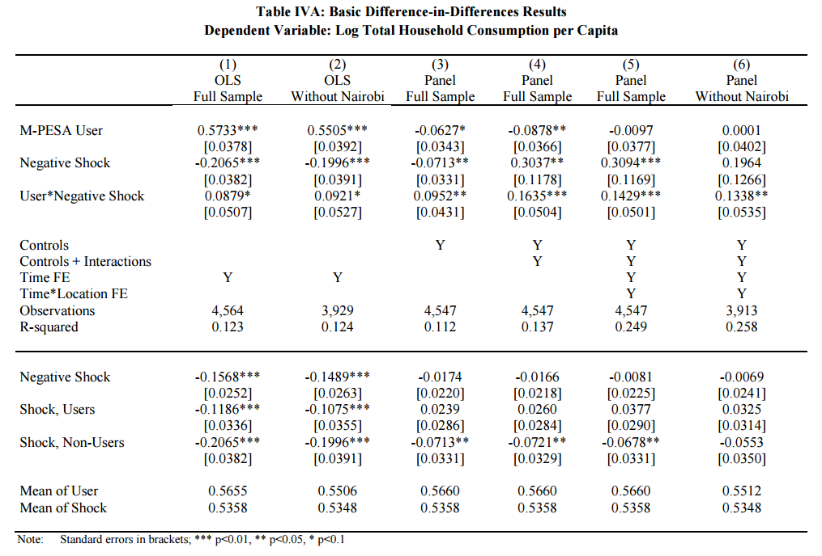

Slide 16
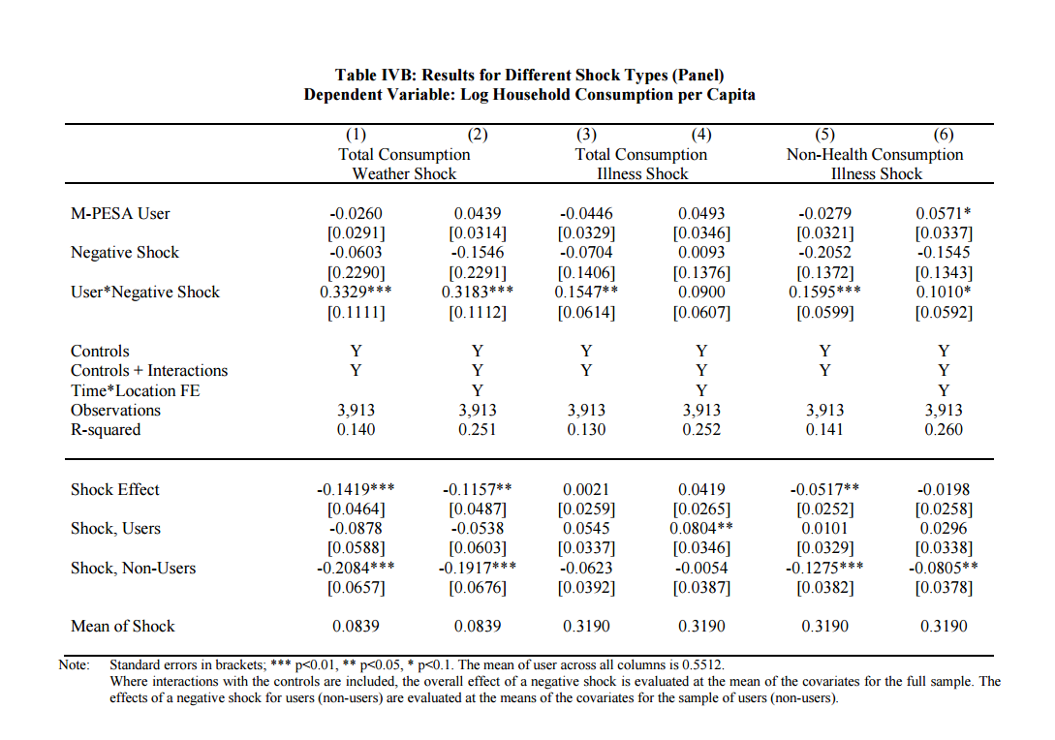

Slide 17
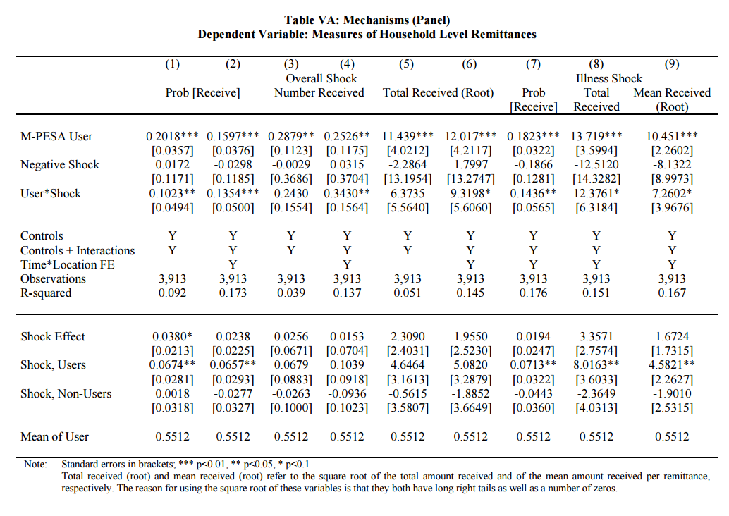

Slide 18
